Slide 1

Probability of entering your dream Graduation Program
Sean Xu
DATA1030 Fall22 S01
Hands-on Data Science
October 17th 2022
http://localhost:8908/notebooks/Desktop/brown/DATA1030-Fall2022/final%20project/Final%20project-data%20set%20of%20Graduate%20Admission.ipynb

Slide 2
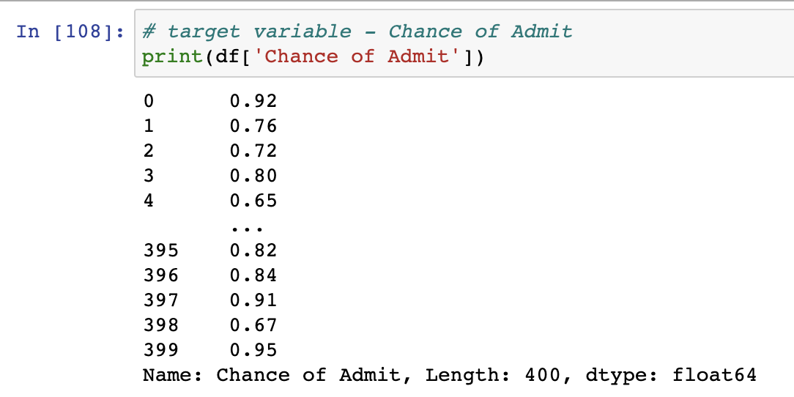
Introduction
Problem:
Whether you can enter your dream program?
What can you do to improve the probability?
Target variables: Chance of Admitted
Regression: Probability (0% - 100%)
Kaggle: UCLA Database
Notes:
People always say that College admission is magic; there are chances you see people who have lower gre or tofel than you but being admitted while you don’t, and there are chances that you think you have a really low chance to be admitted, but you are. Because these opinions just come with common sense or experience, I want to have a logical prediction of whether one can enter your dream program, what is the possibility of it, and what you can do to improve your possibility to admission. It is meaningful because if it predicts well, it is more reliable than some admission consulting companies that told parents the probability of admission for their child only based on experience.
Regression not classification because my target variable is chance of admission, it is from 0%-100% instead of a ranking at 1-5, it is a number in a range

Slide 3
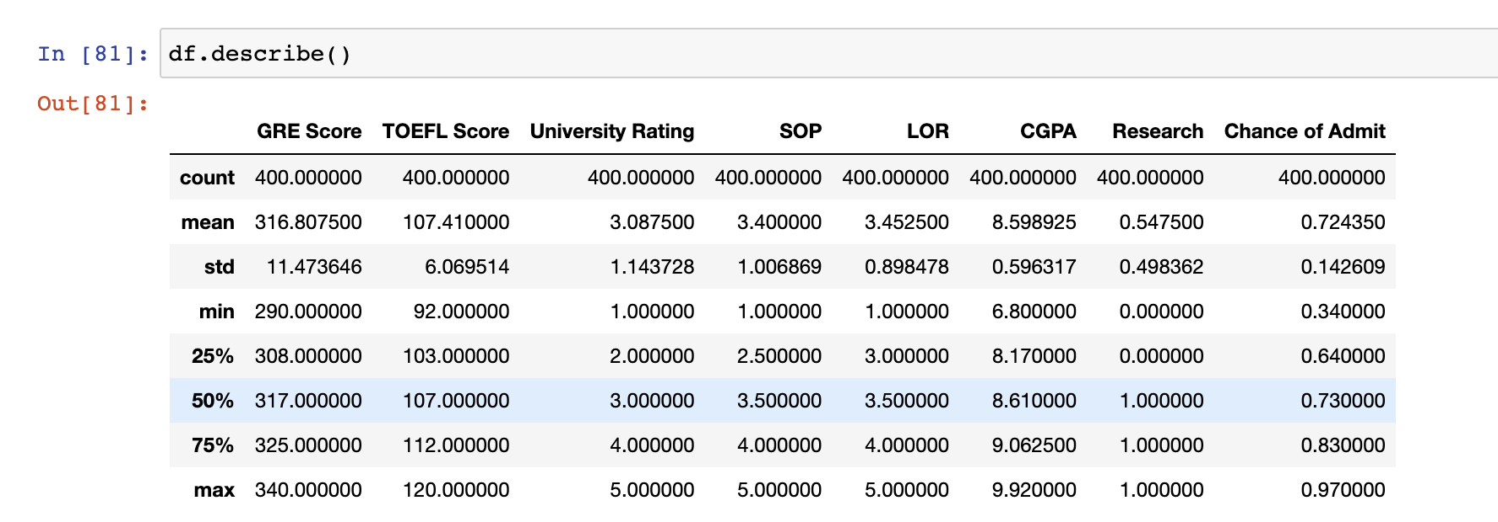
EDA
GRE Scores ( out of 340 )
TOEFL Scores ( out of 120 )
University Rating ( out of 5 )
Statement of Purpose ( out of 5 )
Letter of Recommendation Strength ( out of 5 )
Undergraduate GPA ( out of 10 )
Research Experience ( either 0 or 1 )
Target: Chance of Admit ( ranging from 0 to 1 )
Continuous
Ordinary
Categorized
World average GRE score in 2022
Quantitative Reasoning: 153.66.
Verbal Reasoning: 150.37 in total = 301.03
Notes:
There are 7 figures in the prediction of the Chance of admission
The words in blue are Ordinary variables because they are all in ranked, while they have different levels so it is not continuous
The words in black are continuous variables because they are random numbers in a range
The words in green is categorized because the result 0 or 1 just saying yes or no
One interesting point is the mean of the GRE score in the data set is much higher than the average GRE score in 2022. That could be because it is a UCLA dataset, so the candidates all have a relatively good score. In this case, if the candidates’ dream school has a ranking lower than UCLA, the final result of the Chance of Admission might be higher than what we predict.

Slide 4
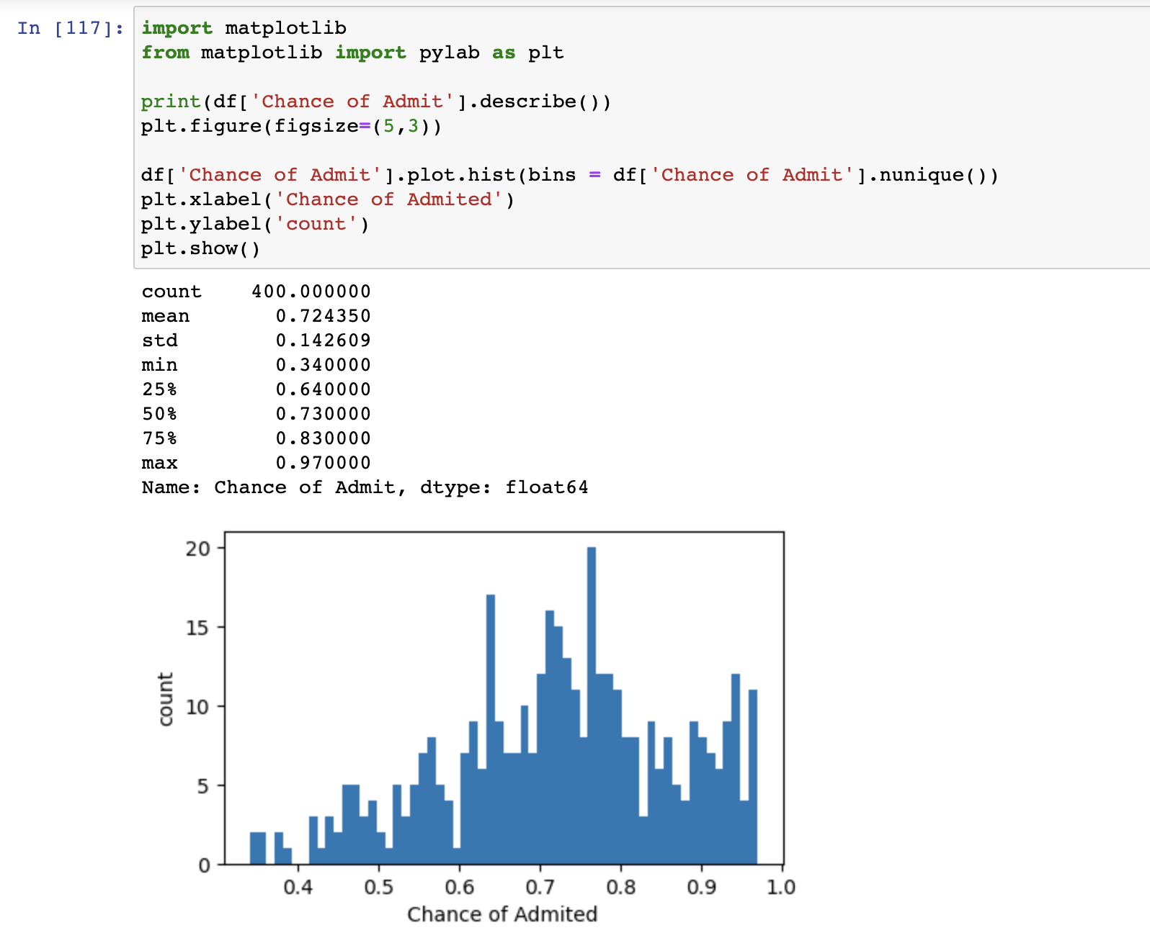
Target Variable
Notes:
For the target variables, The mean is 0.72%, which is much higher than I expected

Slide 5
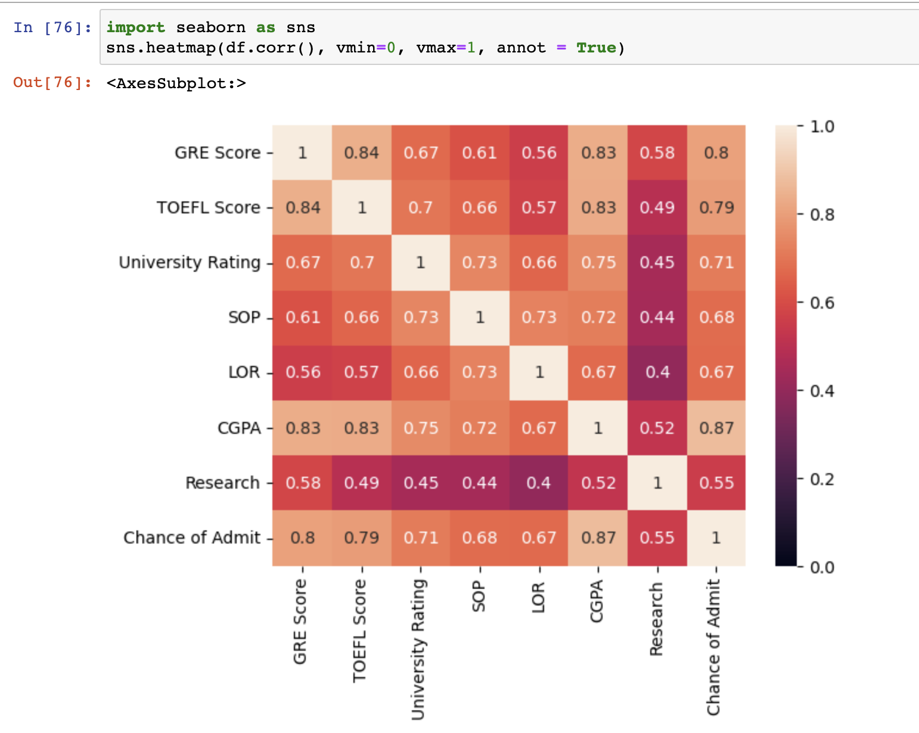
EDA
Not so surprising
V.S. target variables
Highest three:
GPA (0.87) GRE (0.8) TOFEL (0.79)
Lowest:
Research (0.55)
Hard skills
GPA and GRE and Tofel are all over 0.8
Soft skills
LOR and SOP are all over 0.7
But what surprised me was
University ranking
Notes:
First, I want to use the heatmap to show a broad correlation of the Chance of Admission to all other features
More close to 1, the more relative they are
Not surprisingly, GRE, Tofel, and GPA are three figures that has the highest correlation to target variable(chance of admission), around 8
And the lowest score is research, 0.55
And hard skills are correlated with each other which make sense that students who are good at study has high GPA, also with GRE and Tofel.
So as the soft skills.
But what surprised me was the correlation of university ranking with others. As normal, we will think that the higher the school rank is, the higher are score should be, and the Statement of Purpose should focus more on individual rather than school ranking, but the result is the opposite. The school of ranking is more correlated to SOP rather than gre.

Slide 6
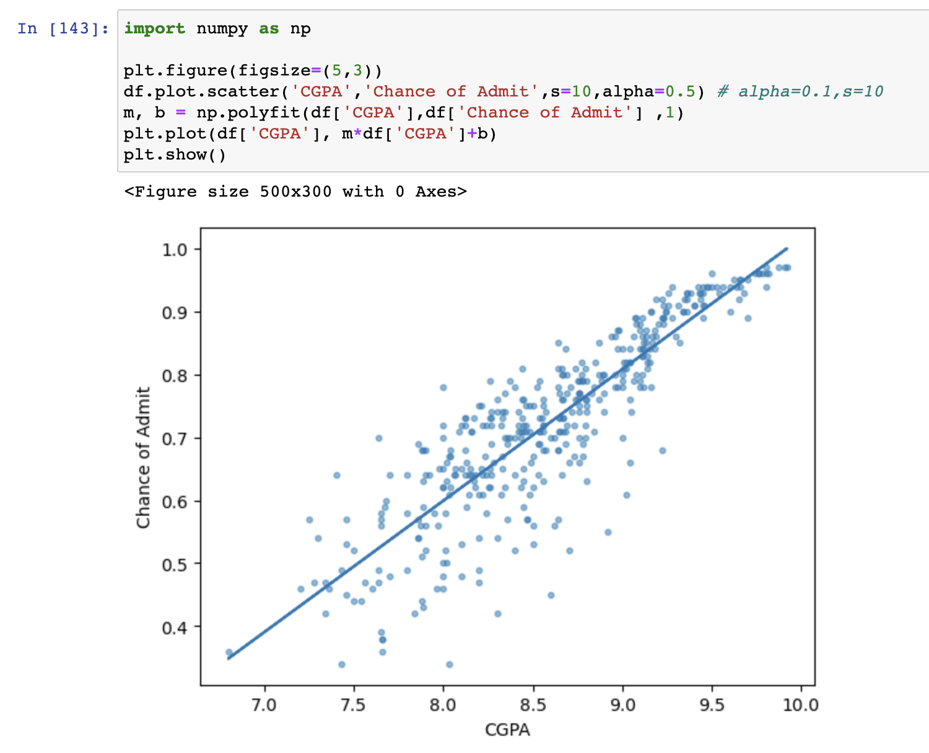
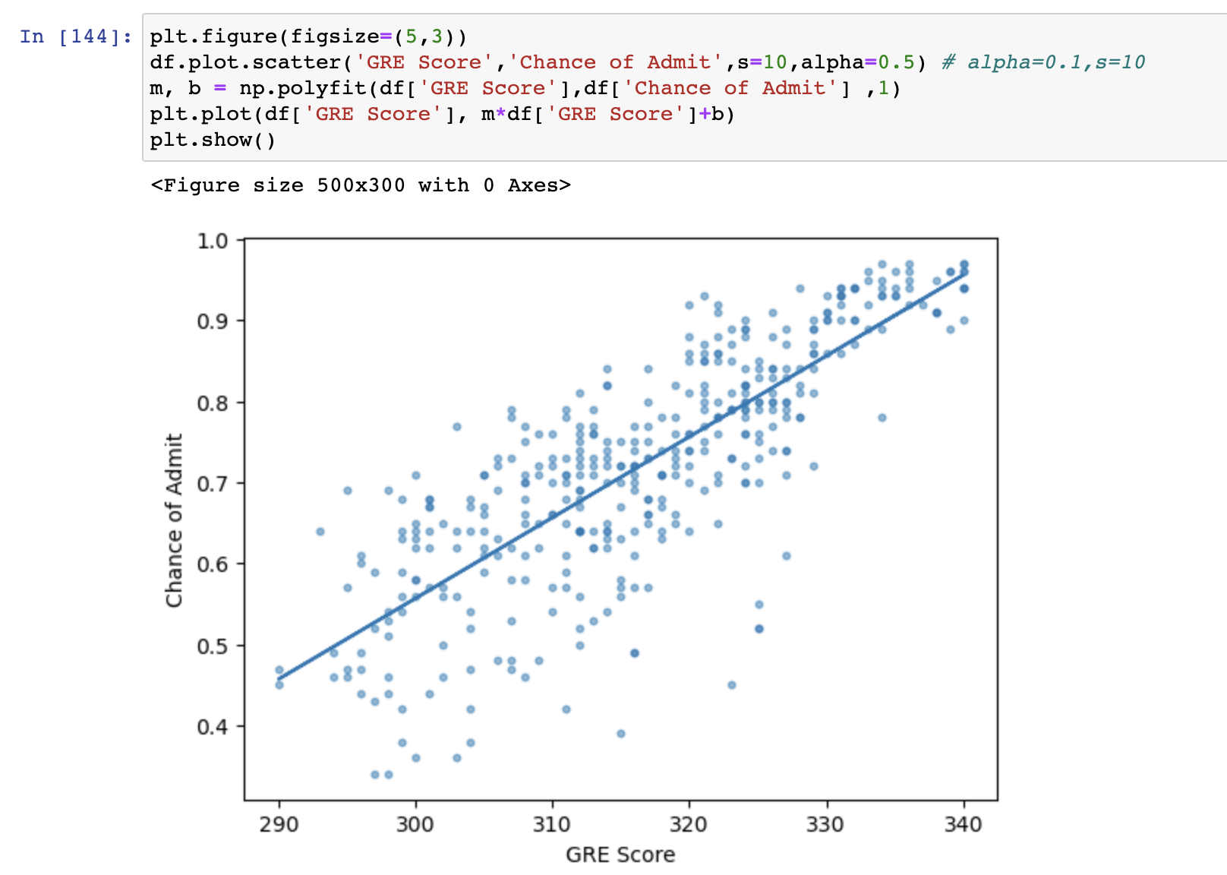
EDA
Continuous vs. Continuous
Notes:
CGPA and GRE scores are two most relevant features to Chance of Admit, we can see the line linear correlation, both CGPA and GRE score with Chance of admitted are kindly in linear correction and the slope of CGPA is nearly 45 degree while GRE score to Chance of admission has a more shallow slope here. That means an increase of the same percentage of CGPA will affect the Chance of admission more than GRE did.

Slide 7
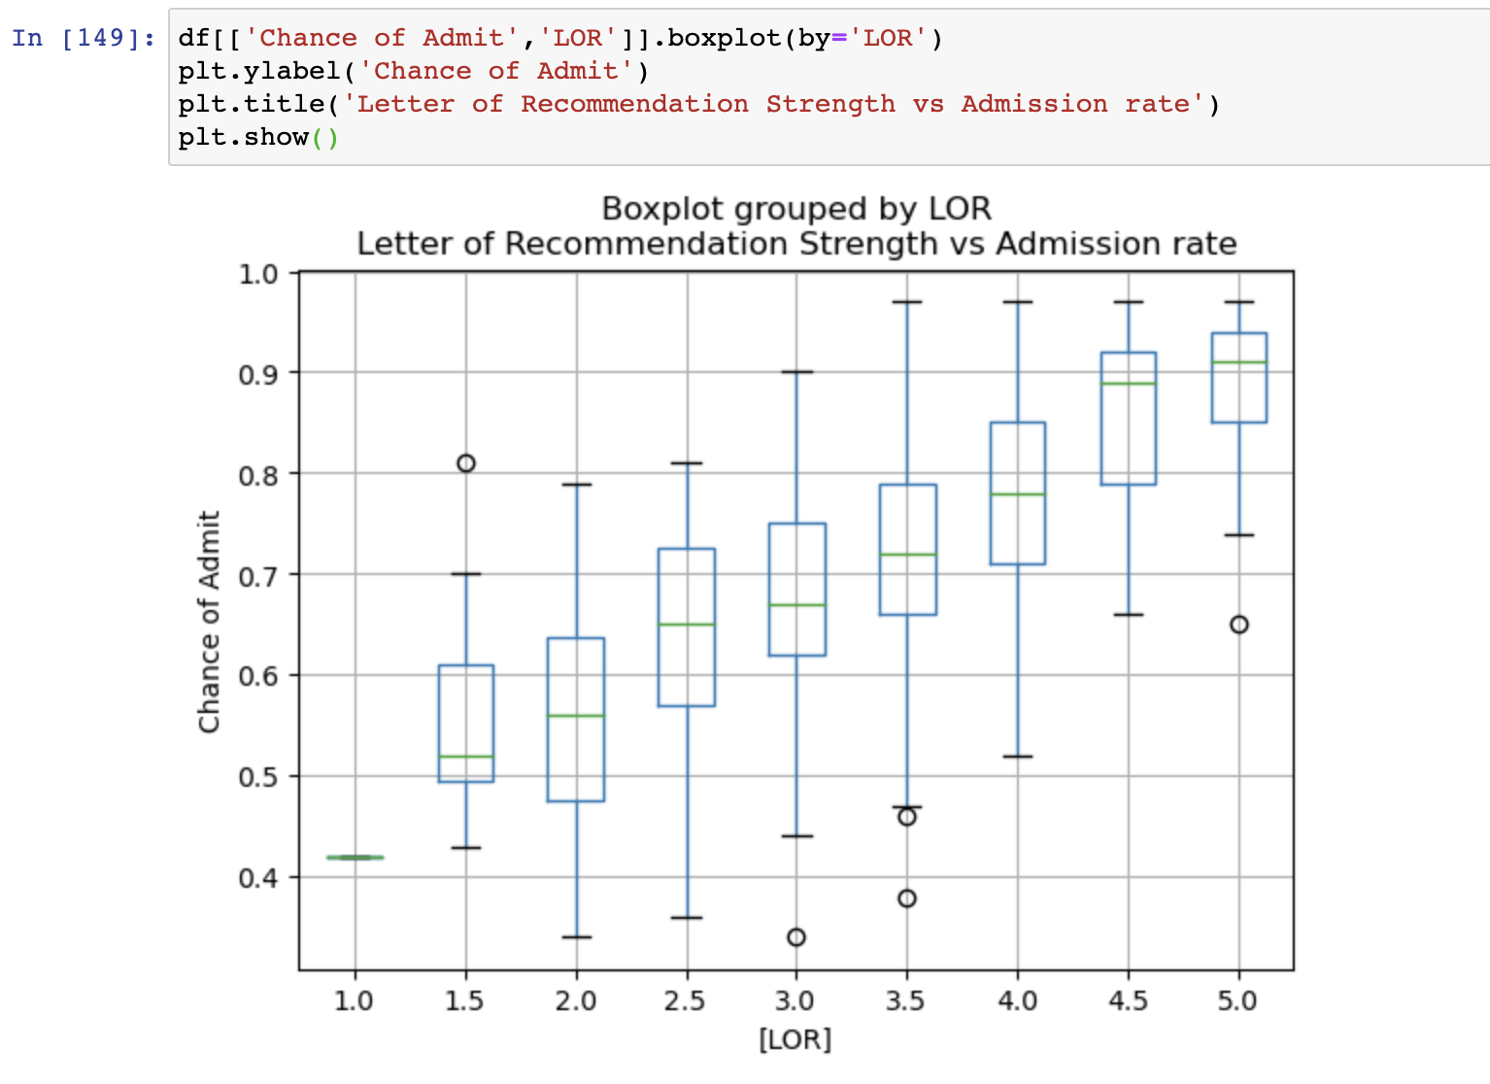
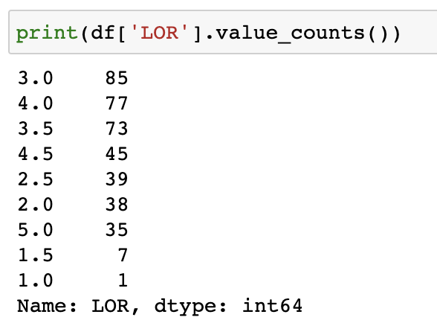
EDA
Continuous vs. Ordinary
If we want the chance of admission >90%
Need LOR strength more than 3
Although LOR increase will increase mean
Huge change 4 – 4.5
Not much change 4.5-5
Notes:
Also, not much outliers
That means after a certain level of strength of recommendation letter, it make less differences in Chance of admission

Slide 8
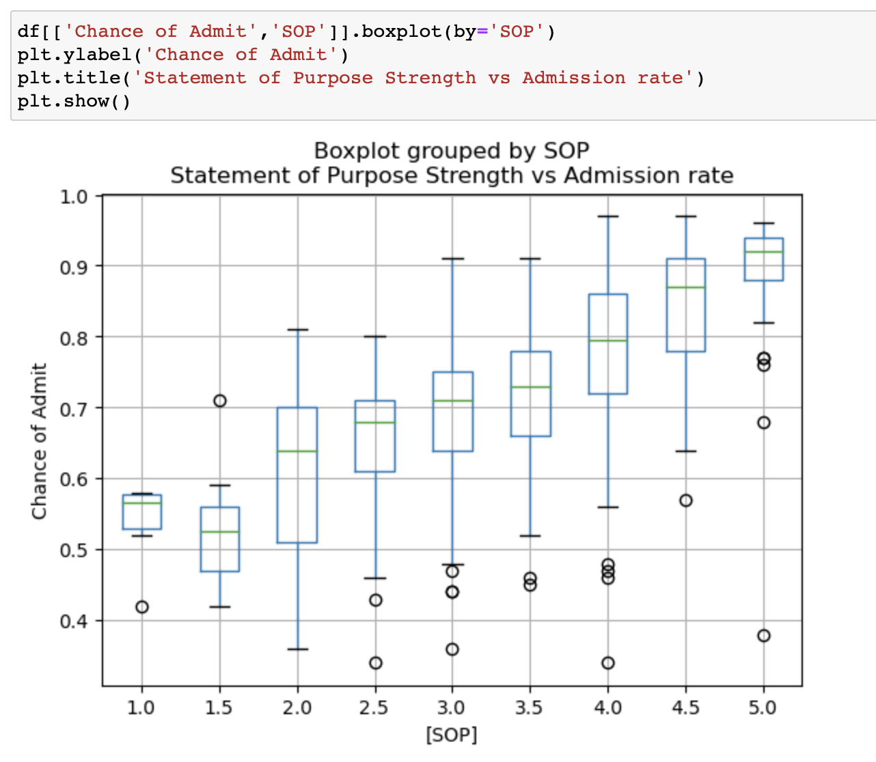
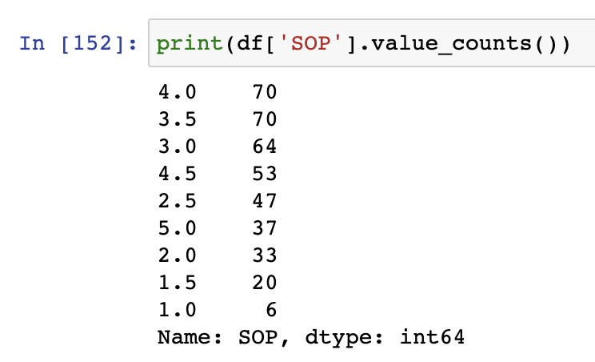
EDA
Continuous vs. Ordinary
Something Same as LOR
The maximum chance of admission of 5.0 is lower than 4.5
Much more outliers
Even in 5.0 SOP, have a 40% chance of admission
Notes:
For the statement of purpose strength, it is generally same as LOR, like 4.5-5 increase little mean while 4.0-4.5 increase huge,
But it makes some differences.
The maximum chance of admission is not highest when SOP is highest. That doesn’t happen in any other features. Might because the small data size but it is strange
There are much more outliers than LOR, and by looking at SOP from 2.5-5, there are some outliers lower than 40% chance of admission, even in 5.0

Slide 9
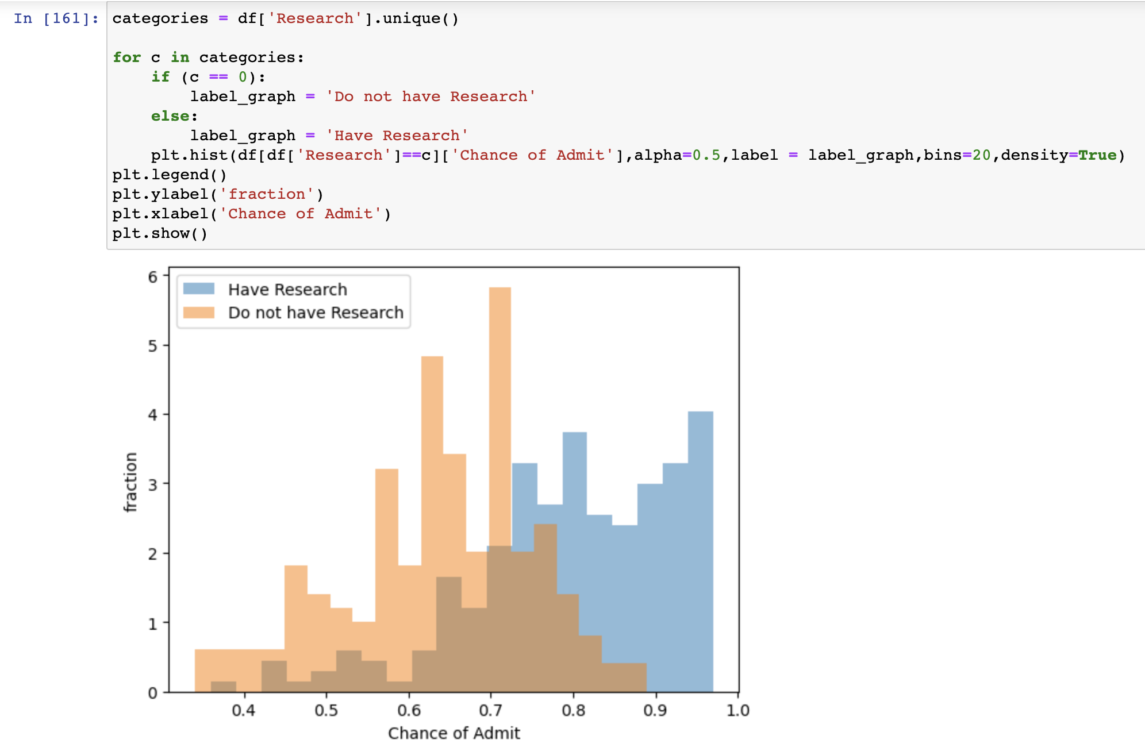
EDA Continuous vs. categorized
Most of the people do not have research has less than 75% chance of admit
If you want chance of admit > 90% need research
Notes:
While most of people have research have 70% chance of admit

Slide 10
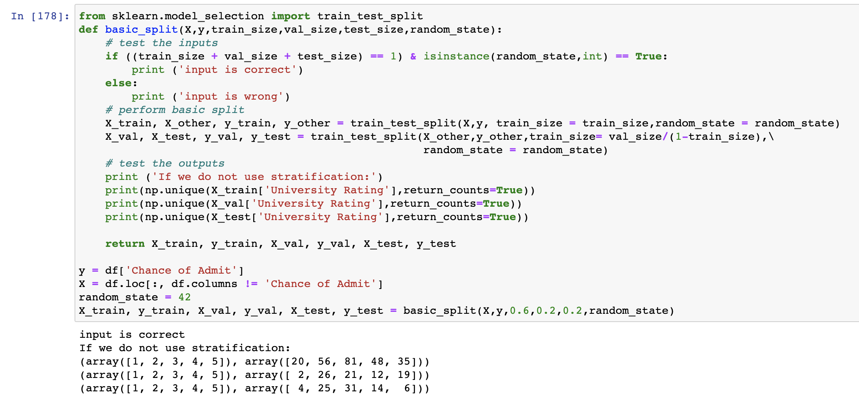
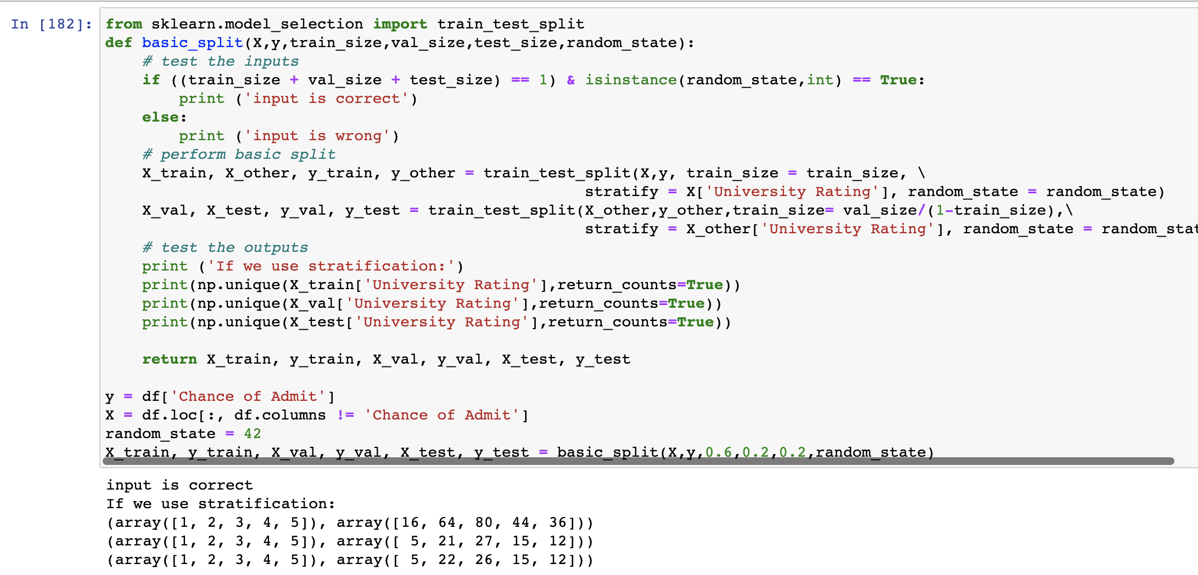
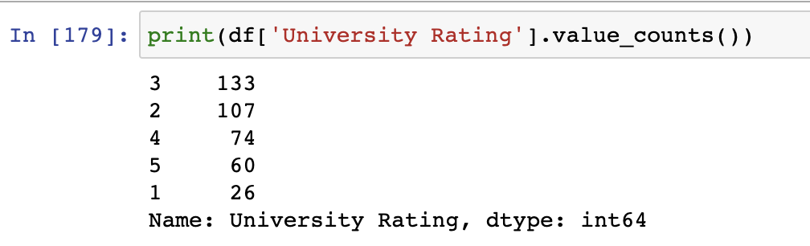
Splitting Data
One thing I notice:
Size of Data set is small, it has only 400 rows
Notes:
There is one thing I notice, there is less University rating really low and really high
In this case, if I just do basic splitting, the result will be like that, in validation and testing set, there will be so less data on rating 1 or 5 universities
So we should use stratification based on University rating

Slide 11
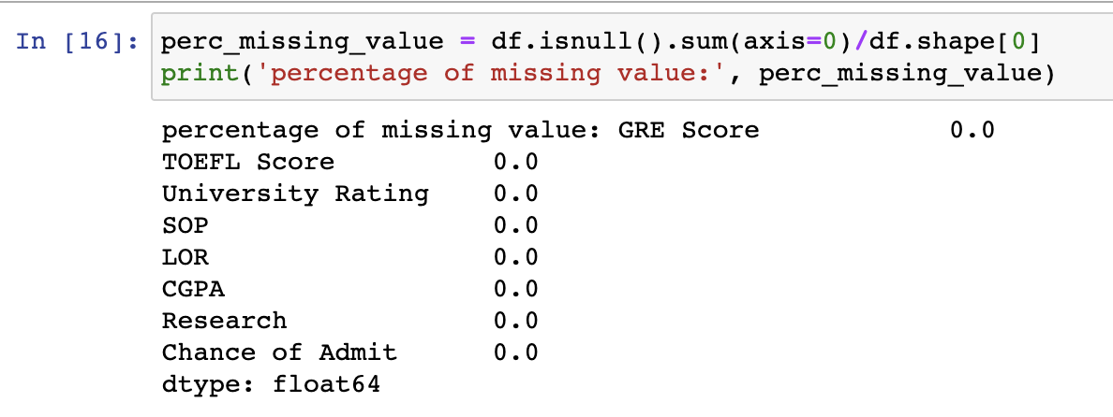
Missing Values
It is a well designed and organized data set
Notes:
There are no missing values there

Slide 12
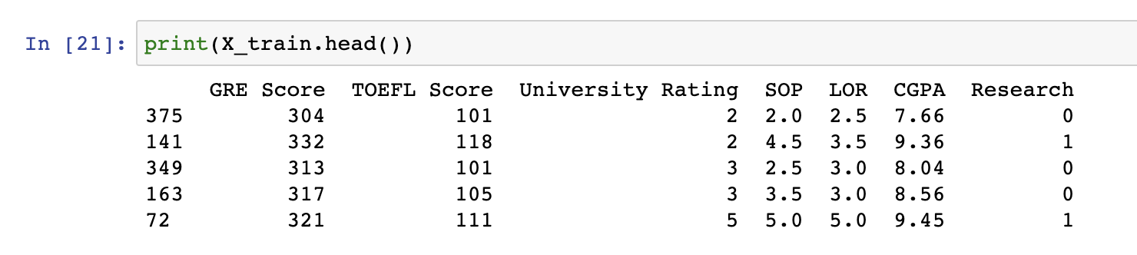
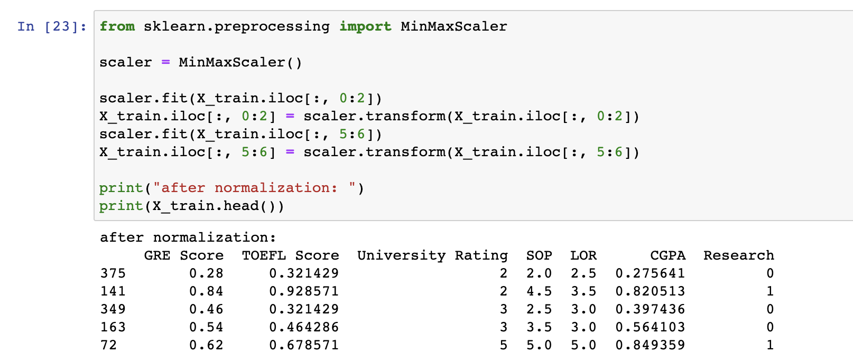
Preprocessing
Standardized GRE, TOFEL, and GPA
Use MinMax scaler
Notes:
Because the dataset is well-organized, there is not much I should do to deal with preprocessing
The categorized and ordinary variables are all in well form; what I have to do is to standardize GRE, TOFEL and GPA scores using minmax scaler because
They are continuous and in a range
They transform into 0-1 scale

